Slide 1
Concussions:
Recognition, Assessment, Management, & Return to Play Guidelines
Stan Skolfield, ATC, CSCS

Slide 2
My Background
Athletic Trainer/Strength Coach with 20 years experience
  USM, Boston Red Sox, various high schools
  Covered almost every sport
  Coordinated medical coverage for all MMA events in Maine
    Travis Wuiff
Currently the OA Performance Center/Parisi Speed School Manager
Gorham resident and son plays football

Slide 3
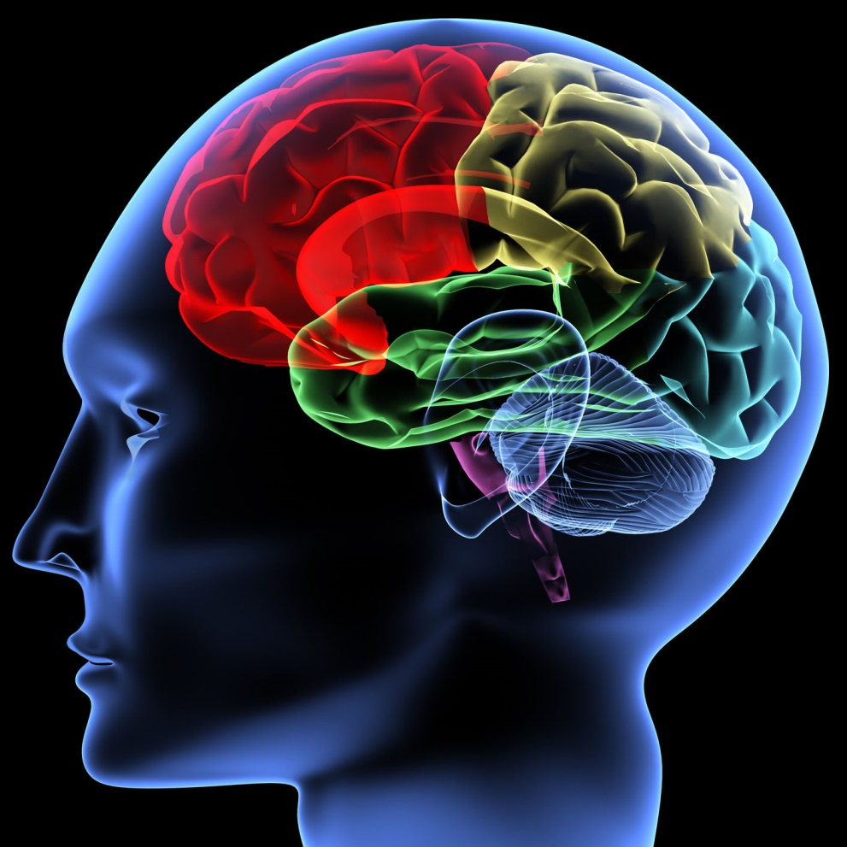
What Is A Concussion?
A Concussion is a traumatic brain injury that alters the way the brain functions. Even the slightest shaking or jarring can potentially cause a disruption to the neurological function of the brain.

Slide 4

Signs and Symptoms
Loss of Consciousness
Headache
Confusion
Dizziness
Sensitivity to Light or Sound
Irritability
Memory Loss
Nausea
Tinnitus (Ringing In The Ears)
Pupillary Changes (dilated, unequal)
Loss of Coordination or Balance
Feeling Sluggish
Slower Reaction Time

Slide 5
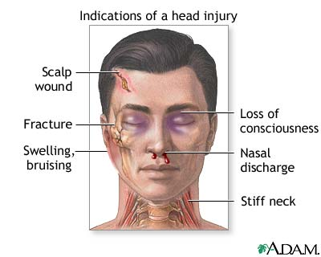
Signs and Symptoms cont…
Unusual lumps or depressions on the head
Blood or other fluids in the ears or nose
Profuse bleeding from the head
Seizures
Impaired breathing
Impaired vision

Slide 6
Concussion; Signs & Symptoms
Table 2: Selected acute & delayed signs & symptoms suggestive of concussion
Cognitive | Somatic | Affective | Sleep Disturbances
Confusion Anterograde amnesia Retrograde amnesia Loss of consciousness Disorientation Feeling “in a fog”, “zoned out” Vacant stare Inability to focus Delayed verbal & motor responses Slurred/incoherent speech Excessive drowsiness | Headache Dizziness Balance disruption Nausea/vomiting Visual disturbances (photophobia, blurry/double vision) Phonophobia | Emotional lability Irritability Fatigue Anxiety Sadness | Trouble falling asleep Sleeping more than usual Sleeping less than usual
Team Physician Consensus
Conference, Herring et al, 2011

Slide 7
Second Impact Syndrome
Second Impact Syndrome (SIS) is caused by rapid swelling of the brain tissue whenever an athlete suffers a secondary concussive impact after the symptoms of the first concussion have yet to resolve.
The brain needs adequate time to heal from an injury such as a concussion.
A second impact is often fatal, and those who do survive are severely disabled from this catastrophic injury. Extra caution should be taken before allowing an athlete to return to play prematurely.

Slide 8
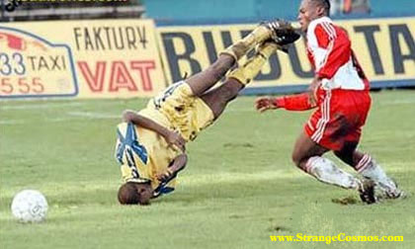
Primary Assessment
Must be able to recognize and interpret the S/S of a head injury
If an athlete is unconscious, ALWAYS assume injury to the neck as well

Slide 9
Primary Assessment cont…
Without moving the athlete, assess the airway
Athlete is breathing
Airway is obstructed
Observe for S/S of head and neck injury
Face color
Skin condition
Pulse
Breathing
Pupils
Edema (swelling)
Ecchymosis (bruising)
Deformity

Slide 10
Secondary Assessment
Assess mental orientation and memory
What is your name?
How old are you?
Where are you?
What game are you playing?
What is the score?
What month is it?
Who is president?
Ask to remember a series of numbers
After 5-10 minutes, ask the same questions again

Slide 11
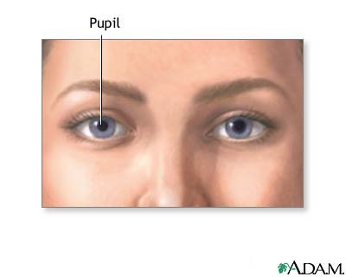
Secondary Assessment cont…
Test for “Eye signs”
Dilated and/or irregular pupils
Blurred vision
Inability for eyes to accommodate rapidly to light variance
Inability for eyes to track smoothly

Slide 12
Secondary Assessment cont…
Balance Testing
Stand with eyes closed
Stand on one foot
Stand on one foot with eyes closed
Finger-to-Nose test
Babinski Test
  Reflex tested by running a pointed object along the bottom of the foot
  Normal response is toe flexion

Slide 13
Concussion Grades
Grade I
No loss of Consciousness
Symptoms resolve >15 minutes
Remove from activity and assess every 5 minutes.
  (Take the helmet)
With post concussion symptoms, disqualify from further activity.
Symptom free after 15 minutes, athlete may return to activity
Grade 2
Transient confusion but no loss of consciousness.
Symptoms last <15 minutes.
May include more severe symptoms such as memory loss, balance issues, nausea etc.
Disqualify from activity and see physician as soon as possible.
Grade 3
Loss of consciousness.
Potential spinal cord issues.
Convulsions
Collapse of the cardiorespiratory system.
Activate EMS immediately.

Slide 14
Protocol
Do not give athlete medication for a headache
Clearance for return to play should be handled by a medical professional, preferably a sports medicine physician*.
  On-field assessment of athlete.
  Contact parents as soon as possible.
  Contact referred physician of incoming athlete.
  Follow up with athlete upon return to school.
  Post-concussion Impact testing.
  Athlete can return to play once physician clears them, they are symptom free, and ImPACT scores are back to baseline.
Grade 1:
  Athletes can return to play if symptoms resolve <15 minutes after impact.
Grade 2:
  Athlete can only return to play after being evaluated by a team physician.
Grade 3:
  Call EMS immediately upon recognition of any Grade 3 Symptoms.
  Return to play protocol is to be determined by physician.

Slide 15
Criteria to Return to Play
Normal neurological function
Normal vasomotor functions (BP, pulse)
Normal balance
Free of headaches
Free of lightheadedness
Free of dizziness
Free of seizures
Functional test (jog, run, jump up and down, cut, spin)

Slide 16
Criteria to Return to Play:
Mild Concussion
First Concussion
  Return to play if asymptomatic
Second Concussion
  Must be asymptomatic for 1 week
Third Concussion
  Terminate season
  May play next year if asymptomatic

Slide 17
Criteria to Return to Play:
Moderate Concussion
First Concussion
  Must be asymptomatic for 1 week
Second Concussion
  Must be asymptomatic for 1 month
Third Concussion
  Terminate season
  May play next year if asymptomatic

Slide 18
Criteria to Return to Play:
Severe Concussion
First Concussion
  Must be asymptomatic for 1 month
Second Concussion
  Terminate season
  May play next year if asymptomatic

Slide 19
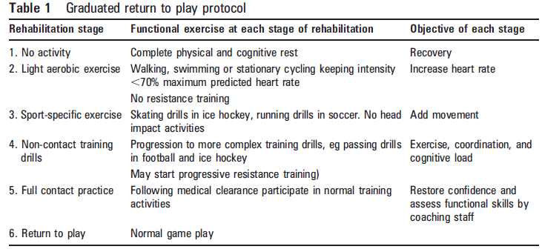
Concussion Management
Progression of Return to Play
Progression should be gradual, and that the time spent at each stage should be individualized (from Vienna Guidelines ’01, Zurich ‘09)

Slide 20
Home/School Activity
Athlete may need to stay home from school
  No TV, texting, electronic games, reading, loud music
  The brain needs rest! Could worsen symptoms
Notify teachers-school work may need to be modified
  Monitor symptoms; headache, inability to concentrate, dizziness
  Prioritize assignments-gradually increase workload

Slide 21
QUESTIONS?
THANK YOU
sskolfield@orthoassociates.com

